Slide 1
Up and Down Side to Side
Game Jam, 1ZHERV
Jan Kvapil, xkvapi19

Slide 2
Topic: Evolution
Platformer
Character evolves as it collects tokens
Jump higher, move faster
Tokens are needed to complete levels
Approx. 2.5-3.5 minutes of playtime
Timer included – Speedrunning possible

Slide 3
Major Challenges
Lack of experience with game development and Unity
Lack of experience with Game Jams
„Am I doing enough?“
„Is this an acceptable outcome?“
Timer positioning
Some parts of the code were tricky to implement
Really bad at graphical design
I did not make most of the assets because they would look horrible
Sound synchronization

Slide 4
Credits
Assets and some functionality: Unity 2D Platformer Template
Inspiration:
Bounce Tales (Nokia game, platformer, 2010) – overall look
Portal and Portal 2 (reset arches)
Sound effects for reset arches: Freesound
Mechanics, Level Design, Idea, Collection Sound Effect, Asset editting: Me

Slide 5
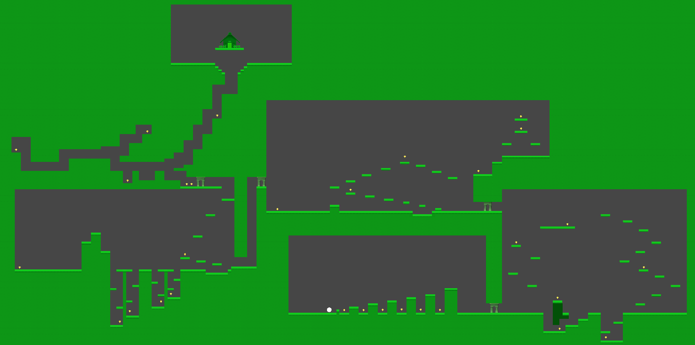
Layout

Slide 6
Thank you for your attention.

